Slide 1

Computer Networks (CET2005B)
School of Computer Engineering and Technology (SCET)
B.Tech Computer Science and Engineering – Cyber security And Forensic
Unit 2: Data Link Layer

Slide 2

Data Link Layer
Contents:
Data Link Layer Services, Types of errors, Block coding, Error Control: Cyclic Redundancy Check (CRC) Code, Hamming Code, Checksum,
sliding window Protocols: Selective Repeat (SR) & Go Back N (GBN), Channel allocation, Multiple Access Protocols: ALOHA, CSMA/CD, CSMA/CA, Ethernet Frame format.

Slide 3
Data Link Layer
The Data-link layer is the second layer from the bottom in the OSI (Open System Interconnection) network architecture model.
It is responsible for the node-to-node delivery of data.
Its major role is to ensure error-free transmission of information.
DLL is also responsible to encode, decode and organize the outgoing and incoming data.
This is considered the most complex layer of the OSI model

Slide 4
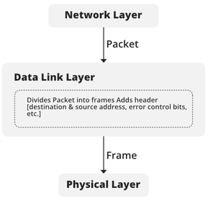
Data Link Layer
At the sender’s side, DLL receives packets from the Network layer and divides them into small frames, then, sends each frame bit-by-bit to the physical layer.
It also attaches some special bits (for error control and addressing) at the header and end of the frame.
At the receiver’s end, DLL takes bits from the Physical layer organizes them into the frame, and sends them to the Network layer.

Slide 5
Data Link Layer
Services provided
Framing
Addressing
Error Control
Flow Control
Access Control

Slide 6
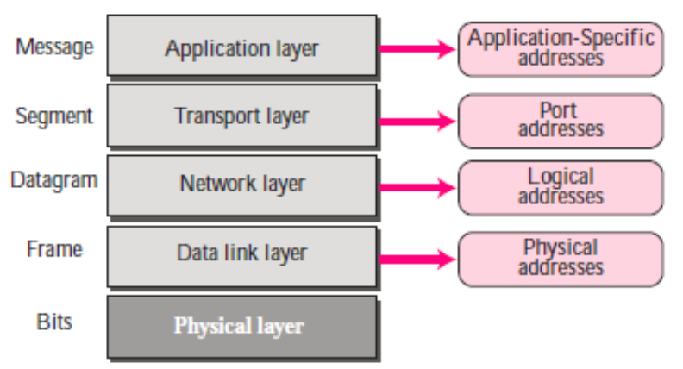
Addresses in TCP/IP Network

Slide 7
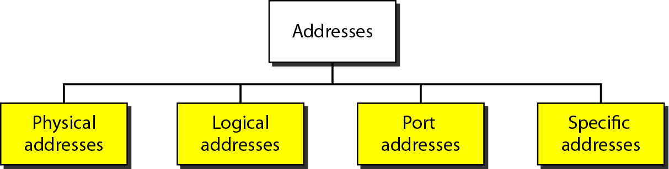
Addresses in TCP/IP Network

Slide 8
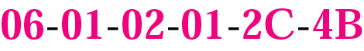
Link Layer Address
Six bytes = 48 bits
Flat address not hierarchical
Burned into the NIC ROM
First three bytes from left specify the vendor. Cisco 00-00-0C, 3 Com 02-60-8C and the last 24 bit should be created uniquely by the company
Destination Address can be:
Unicast: second digit from left is even (one recipient)
Multicast: Second digit from left is odd (group of stations to receive the frame – conferencing applications)
Broadcast (ALL ones) (all stations receive the frame)
Source address is always Unicast

Slide 9
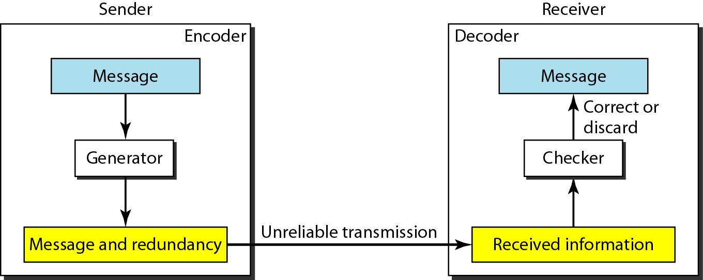
Error Control
To detect or correct errors, we need to send extra (redundant) bits with data.
Enough redundancy is added to detect an error.
In error detection, the receiver knows an error occurred but does not know which bit(s) is(are) in error.
Error detection has less overhead than error correction.

Slide 10
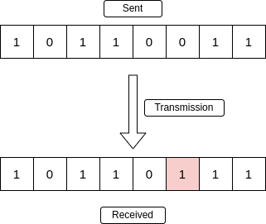
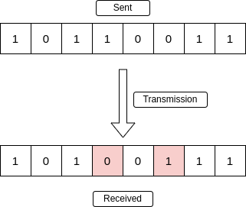
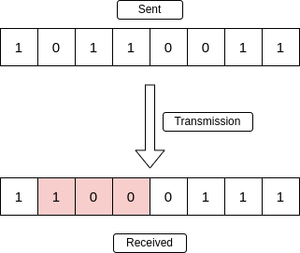
Types of Error
Single-Bit Error
Multiple-Bit Error
Burst Error

Slide 11
Error Detection and Correction Codes
During transmission of binary data from one system to the other, the noise may also be added. Due to this, there may be errors in the received data at other system.
That means a bit 0 may change to 1 or a bit 1 may change to 0. We can’t avoid the interference of noise.
The original data can be recovered first by detecting whether any error is present and then correcting those errors
For this purpose, following codes are used.
Error detection codes
Error correction codes
https://www.tutorialspoint.com/what-are-error-detecting-codes

Slide 12
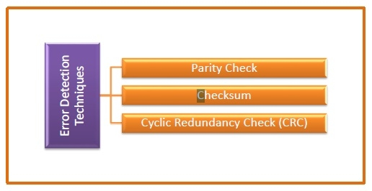
Error Detection Techniques

Slide 13
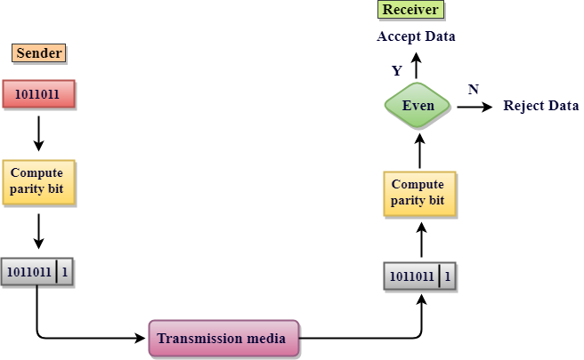
Parity Check
Parity check is done by adding an extra bit, called parity bit to the data to make number of 1s either even in case of even parity, or odd in case of odd parity.
https://www.javatpoint.com/computer-network-error-detection

Slide 14
Parity Check
Parity check is done by adding an extra bit, called parity bit to the data to make number of 1s either even in case of even parity, or odd in case of odd parity.
While creating a frame, the sender counts the number of 1s in it and adds the parity bit in following way
In case of even parity: If number of 1s is even then parity bit value is 0. If number of 1s is odd then parity bit value is 1.
In case of odd parity: If number of 1s is odd then parity bit value is 0. If number of 1s is even then parity bit value is 1.
On receiving a frame, the receiver counts the number of 1s in it. In case of even parity check, if the count of 1s is even, the frame is accepted, otherwise it is rejected. Similar rule is adopted for odd parity check.

Slide 15
Parity Check
Example of Even Parity Code
Binary Code | Even Parity bit | Even Parity Code
000 | 0 | 0000
001 | 1 | 0011
010 | 1 | 0101
011 | 0 | 0110
Parity check is suitable for single bit error detection only.
Example of Odd Parity Code
Binary Code | Odd Parity bit | Odd Parity Code
000 | 1 | 0001
001 | 0 | 0010
010 | 0 | 0100
011 | 1 | 0111

Slide 16
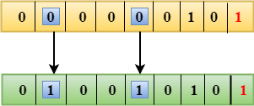
Drawbacks Of Single Parity Checking
It can only detect single-bit errors which are very rare.
If two bits are interchanged, then it cannot detect the errors.
Performance can be improved by using Two-Dimensional Parity Check which organizes the data in the form of a table.

Slide 17
Checksum
A Checksum is an error detection technique based on the concept of redundancy. The checksum is used in the Internet by several protocols although not at the data link layer.
Checksum Sender
The Sender follows the given steps:
The block unit is divided into k sections, and each of n bits.
All the k sections are added together by using one's complement to get the sum.
The sum is complemented and it becomes the checksum field.
The original data and checksum field are sent across the network.
Checksum Checker
The Receiver follows the given steps:
The block unit is divided into k sections and each of n bits.
All the k sections are added together by using one's complement algorithm to get the sum.
The sum is complemented.
If the result of the sum is zero, then the data is accepted otherwise the data is discarded.

Slide 18
Checksum

Slide 19
Checksum Example
Suppose our data is a list of five 4-bit numbers that we want to send to a destination.
For example, if the set of numbers is (7, 11, 12, 0, 6)
Sum of the numbers is 36
The data transmitted (7, 11, 12, 0, 6, −36).
Receiver will add all the numbers including checksum
In this case summation = 0 meaning that the data is received correctly
If the sum is non zero then it is assumed that data has error

Slide 20
Checksum Example
Let us redo Exercise using one’s complement arithmetic.
The sender initializes the checksum to 0 and adds all data items and the checksum (the checksum is considered as one data item
The result is 36. However, 36 cannot be expressed in 4 bits. The extra two bits are wrapped and added with the sum to create the wrapped sum value 6.
The sum is then complemented, resulting in the checksum value 9 (15 − 6 = 9). The sender now sends six data items to the receiver including the checksum 9.

Slide 21
Checksum Example
The receiver follows the same procedure as the sender.
It adds all data items (including the checksum); the result is 45. The sum is wrapped and becomes 15.
The wrapped sum is complemented and becomes 0.
Since the value of the checksum is 0, this means that the data is not corrupted.
The receiver drops the checksum and keeps the other data items.
If the checksum is not zero, the entire packet is dropped.

Slide 22
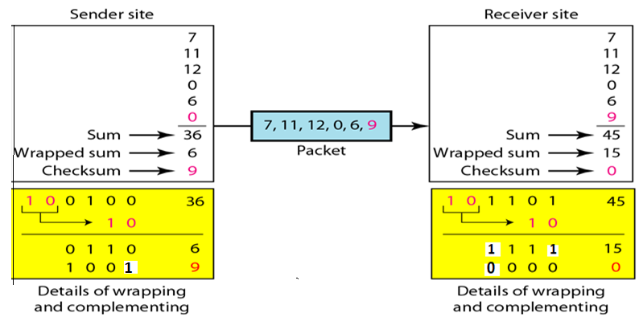
Checksum Example

Slide 23
Checksum
Advantages
Simple to implement − It is very simple to implement and uses very minimal hardware and software resources.
Efficient − Checksum codes can detect the most common errors in digital communication.
Fast − Checksum codes can be computed very quickly because there is nothing much to do here, which is why it is suitable for real-time data packet transmissions.
Low Latency − As we discussed it won’t use many resources and very few computations that’s why latency is very low here.

Slide 24
Checksum
Disadvantages
Limited Error Detection Capability − it is versatile and easy to implement having less complexity but the main problem is it is limited to very common errors in other words it can detect very common errors.
Limited Error Correction Capability − Checksum codes can detect errors in the data packet but they can’t correct them. So it is only an error detection technique.
Susceptible to errors − Checksum codes can be susceptible to errors, especially in cases where multiple errors occur in the same data packet.
Sensitivity to the Data Packet size − checksum codes are sensitive to the length of the data packet, if the size of the data packet is too small then very high chances are there that it might miss the error. While the data packet size is large, the overhead of the checksum increases.

Slide 25
Cyclic Redundancy Check (CRC)
A cyclic redundancy check (CRC) is an error-detecting code commonly used in digital networks and storage devices to detect accidental changes to raw data
Unlike the checksum scheme, which is based on addition, CRC is based on binary division.
In CRC, a sequence of redundant bits, called cyclic redundancy check bits, are appended to the end of the data unit so that the resulting data unit becomes exactly divisible by a second, predetermined binary number.
At the destination, the incoming data unit is divided by the same number. If at this step there is no remainder, the data unit is assumed to be correct and is therefore accepted.
A non zero remainder indicates that the data unit has been damaged in transit and therefore must be rejected.

Slide 26
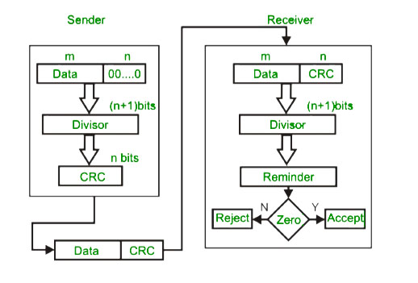
Cyclic Redundancy Check (CRC)

Slide 27
Cyclic Redundancy Check (CRC)
Modulo 2 Division: The process of modulo-2 binary division is the same as the familiar division process we use for decimal numbers. Just that instead of subtraction, we use XOR here.
In each step, a copy of the divisor (or data) is XORed with the k bits of the dividend (or key).
The result of the XOR operation (remainder) is (n-1) bits, which is used for the next step after 1 extra bit is pulled down to make it n bits long.
When there are no bits left to pull down, we have a result. The (n-1)-bit remainder which is appended at the sender side.

Slide 28
Standard Polynomials
Generator polynomial = x³ + x² + 1
= 1x³ + 1x² + 0x¹ + 1x⁰
Key = 1101

Slide 29
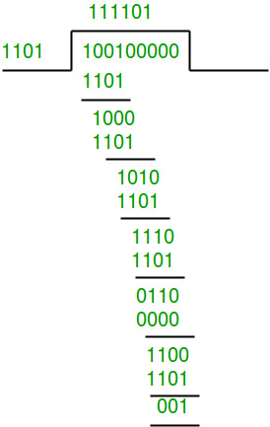
CRC: Example 1- Sender side
Data word to be sent – 100100
Key = 1101
The remainder is 001 and hence the encoded data sent is 100100001.

Slide 30
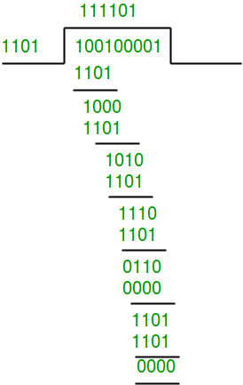
CRC: Example 1- Receiver side
Code word received at the receiver side is 100100001
The remainder is all zeros. Hence, the data received has no error.

Slide 31
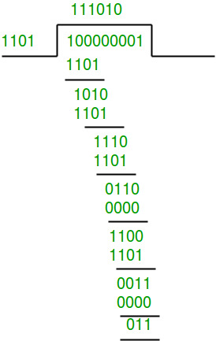
CRC: Example 2- Receiver side
Code word received-100000001
Key - 1101
Since the remainder is not all zeroes, the error is detected at the receiver side

Slide 32
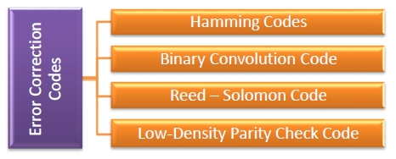
Error-correcting codes
Error-correcting codes (ECC) are a sequence of numbers generated by specific algorithms for detecting and removing errors in data that has been transmitted over noisy channels.
Error correcting codes ascertain the exact number of bits that has been corrupted and the location of the corrupted bits
Types of Error Correcting Codes

Slide 33
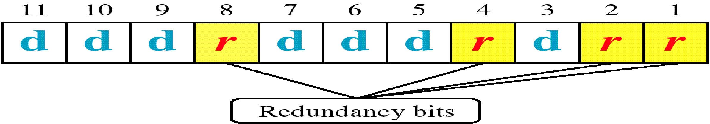
Hamming Code
Hamming code is a block code that is capable of detecting up to two simultaneous bit errors and correcting single-bit errors
The source encodes the message by inserting redundant bits within the message.
These redundant bits are extra bits that are generated and inserted at specific positions in the message itself to enable error detection and correction.
When the destination receives this message, it performs recalculations to detect errors and find the bit position that has error.

Slide 34
Hamming Code: Encoding
Encoding a message by Hamming Code
Step 1 − Calculation of the number of redundant bits.
Step 2 − Positioning the redundant bits.
Step 3 − Calculating the values of each redundant bit.
Step 1
If the message contains m number of data bits, then r number of redundant bits are added to it.
The value of r must satisfy the following relation: 2^{r} ≥ m+r+1.
For example: If data bits m = 7 then r = 4
Length of the code-word = 7 + 4 =11

Slide 35
Hamming Code: Encoding
Step 2
The r redundant bits placed at bit positions of powers of 2, i.e. 1, 2, 4, 8, 16 etc.
They are referred as r₁ (at position 1), r₂ (at position 2), r₃ (at position 4), r₄ (at position 8) and so on.
Step 3
The redundant bits are parity bits. A parity bit is an extra bit that makes the number of 1s either even or odd. The two types of parity are −
Even Parity − Here the total number of bits in the message is made even.
Odd Parity − Here the total number of bits in the message is made odd.

Slide 36
Hamming Code: Encoding
Each redundant bit, r_{i}, is calculated as the parity, generally even parity, based upon its bit position. It covers all bit positions whose binary representation includes a 1 in the i^{th} position except the position of r_{i}
r₁ is the parity bit for all data bits in positions whose binary representation includes a 1 in the least significant position excluding 1 (3, 5, 7, 9, 11 and so on)
r₂ is the parity bit for all data bits in positions whose binary representation includes a 1 in the position 2 from right except 2 (3, 6, 7, 10, 11 and so on)
r₃ is the parity bit for all data bits in positions whose binary representation includes a 1 in the position 3 from right except 4 (5-7, 12-15, 20-23 and so on)

Slide 37
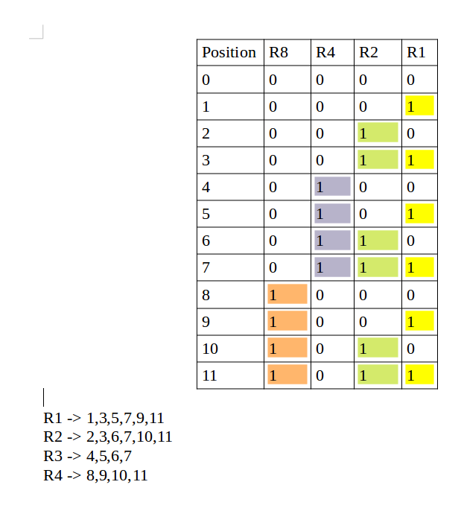
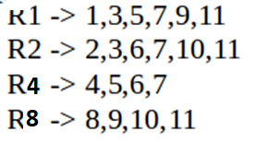
Hamming Code: Encoding
Sometimes the redundant bits are named as per their position eg. R1, R2, R4, R8 etc. instead of R1, R2, R3, R4. In both the cases calculation process remains the same

Slide 38
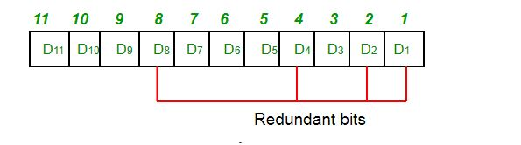
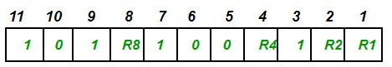
Hamming Code: Encoding
The number of data bits = 7 (m)
The number of redundant bits = 4 (r)
The total number of bits = 11 (n = m + r)
The redundant bits are placed at positions corresponding to power of 2- 1, 2, 4, 8
data to be transmitted is 1011001

Slide 39
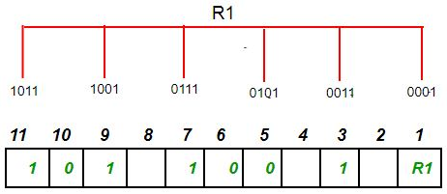
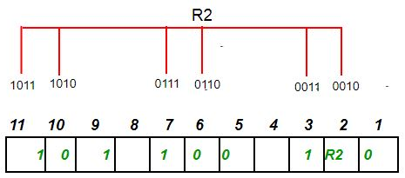
Hamming Code: Encoding
Determining the Parity bits:
To find the redundant bit R1, we check for even parity. Since the total number of 1’s in all the bit positions corresponding to R1 is an even number.
R1= 0
To find the redundant bit R2, we check for even parity. Since the total number of 1’s in all the bit positions corresponding to R2 is odd.
R2 = 1

Slide 40
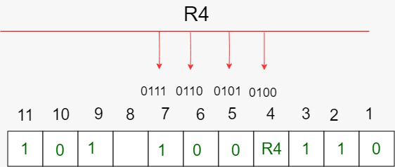
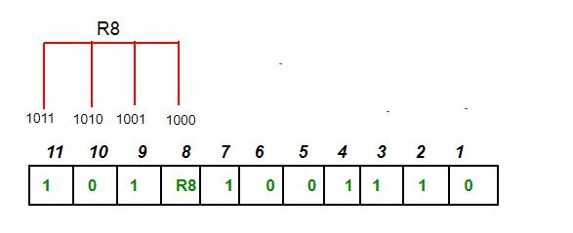
Hamming Code: Encoding
Determining the Parity bits:
To find the redundant bit R4, we check for even parity. Since the total number of 1’s in all the bit positions corresponding to R4 is odd
R4 = 1
To find the redundant bit R8, we check for even parity. Since the total number of 1’s in all the bit positions corresponding to R8 is an even number
R8 = 0

Slide 41
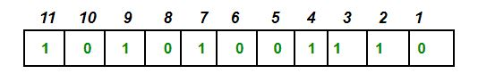
Hamming Code: Encoding
Thus, the data transferred is:

Slide 42
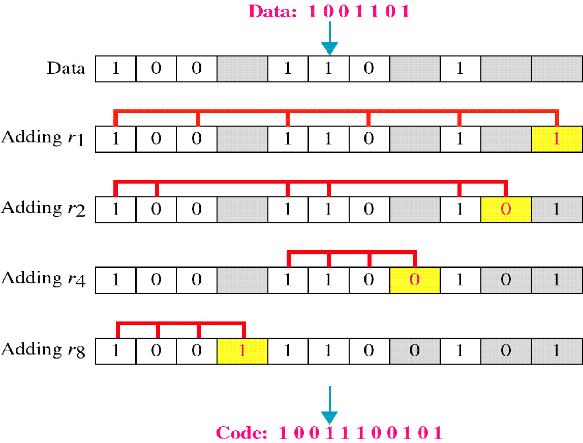
Hamming Code: Encoding
Consider an Example, Data:1001101
Use modulo - 2 to calculate parity bits
R1 = D3, D5, D7, D9, D11 => 1+0+1+0+1 => 1.
R2 = D3, D6, D7, D10, D11 => 1+1+1+0+1 => 0.
R4 = D5, D6, D7 => 0+1+1 => 0.
R8 = D9, D10, D11 => 0+0+1 => 1.

Slide 43
Hamming Code: Encoding
Consider another Example where we send data stream 1000001 [ASCII ‘A’]
Now we will encode the message
Use modulo - 2 to calculate parity bits
R1 = D3, D5, D7, D9, D11 => 1+0+0+0+1 => 0.
R2 = D3, D6, D7, D10, D11 => 1+0+0+0+1 => 0.
R4 = D5, D6, D7 => 0+0+0 => 0.
R8 = D9, D10, D11 => 0+0+1 => 1.
Data stream to be sent on transmission line from sender
1
0
0
1
0
0
0
0
1
0
0
11 10 9 8 7 6 5 4 3 2 1

Slide 44
Hamming Code: Decoding
Once the receiver gets an incoming message, it performs recalculations to detect errors and correct them. The steps for recalculation are −
Step 1 − Calculation of the number of redundant bits.
Step 2 − Positioning the redundant bits.
Step 3 − Parity checking.
Step 4 − Error detection and correction
Step 1
Using the same formula as in encoding, the number of redundant bits are ascertained.
Step 2
The r redundant bits placed at bit positions of powers of 2, i.e. 1, 2, 4, 8, 16 etc.

Slide 45
Hamming Code: Decoding
Step 3
Parity bits are calculated based upon the data bits and the redundant bits using the same rule as during generation of c₁,c₂ ,c₃ ,c₄ etc. Thus
c₁ = parity(1, 3, 5, 7, 9, 11 and so on)
c₂ = parity(2, 3, 6, 7, 10, 11 and so on)
c₄ = parity(4-7, 12-15, 20-23 and so on)
Step 4
The decimal equivalent of the parity bits binary values is calculated. If it is 0, there is no error. Otherwise, the decimal value gives the bit position which has error.
For example, if c4c3c2c1 = 1001, it implies that the data bit at position 9
The bit is flipped to get the correct message.

Slide 46
Hamming Code: Example
when this stream is received at receiver same process will be followed for decoding if we are getting same values for parity bits as we got at sender side then we say that transmission was error free
Consider an erroneous stream where 5th bit is flipped
Data stream received on transmission line from sender
1
0
0
1
0
0
1
0
1
0
0
11 10 9 8 7 6 5 4 3 2 1
Now getting corrupted bit position
= (C8, CR4, C2, C1)
= (0, 1, 0, 1)₂
= (5)₁₀
C1 = R1, D3, D5, D7, D9, D11 => 0+1+1+0+0+1 => 1.
C2 = R2, D3, D6, D7, D10, D11 => 0+1+0+0+0+1 => 0.
C4 = R4, D5, D6, D7 => 0+1+0+0 => 1.
C8 = R8, D9, D10, D11 => 1+0+0+1 => 0.

Slide 47
Hamming Code for Detecting Burst Errors
Burst errors are very common, in particular in wireless environments where a fade will affect a group of bits in transit. The length of the burst is dependent on the duration of the fade.
One way to counter burst errors, is to break up a transmission into shorter words and create a block (one word per row), then have a parity check per word.
The words are then sent column by column. When a burst error occurs, it will affect 1 bit in several words as the transmission is read back into the block format and each word is checked individually.

Slide 48
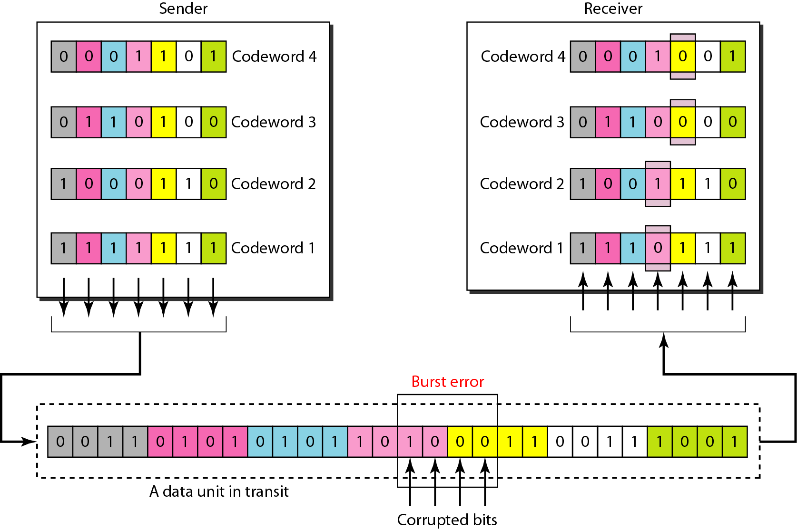
Hamming Code for Burst Errors

Slide 49
DLL task – Flow Control

Slide 50
Flow Control and Error control
The most important responsibilities of the data link layer are flow control and error control. Collectively, these functions are known as data link control.
Flow control refers to a set of procedures used to restrict the amount of data that the sender can send before waiting for acknowledgment.
Error control in the data link layer is based on automatic repeat request, which is the retransmission of data.

Slide 51
Flow Control
Flow control is a technique that allows two stations working at different speeds to communicate with each other.
In data link layer, flow control restricts the number of frames the sender can send before it waits for an acknowledgment from the receiver.
If the rate of produced frames is higher than the rate of consumed frames, frames at the receiving end need to be buffered while waiting to be consumed (processed).
As an unlimited buffer size at the receiving side is not possible, any one of the following steps are followed
Receiving data-link layer drop the frames if its buffer is full.
To let the receiving data-link layer send a feedback to the sending data-link layer to ask it to stop or slow down.
Different data-link-layer protocols use different strategies for flow control

Slide 52
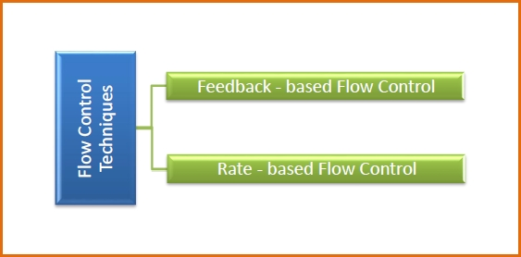
Flow Control
Feedback based Flow Control In these protocols, the sender sends frames after it has received acknowledgments from the user. This is used in the data link layer.
Rate based Flow Control These protocols have built in mechanisms to restrict the rate of transmission of data without requiring acknowledgment from the receiver. This is used in the network layer and the transport layer.

Slide 53
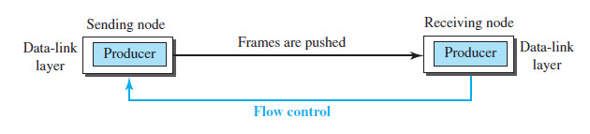
Flow Control
data-link layer at the sending node tries to push frames toward the data-link layer at the receiving node.
If the receiving node cannot process and deliver the packet to its network at the same rate that the frames arrive, it becomes overwhelmed with frames.
Flow control in this case can be feedback from the receiving node to the sending node to stop or slow down pushing frames.

Slide 54
Flow Control
Flow and error control can be combined.
In a simple situation, the acknowledgment that is sent for flow control can also be used for error control to tell the sender the packet has arrived uncorrupted.
The lack of acknowledgment means that there is a problem in the sent frame.
A frame that carries an acknowledgment is normally called an ACK to distinguish it from the data frame.

Slide 55
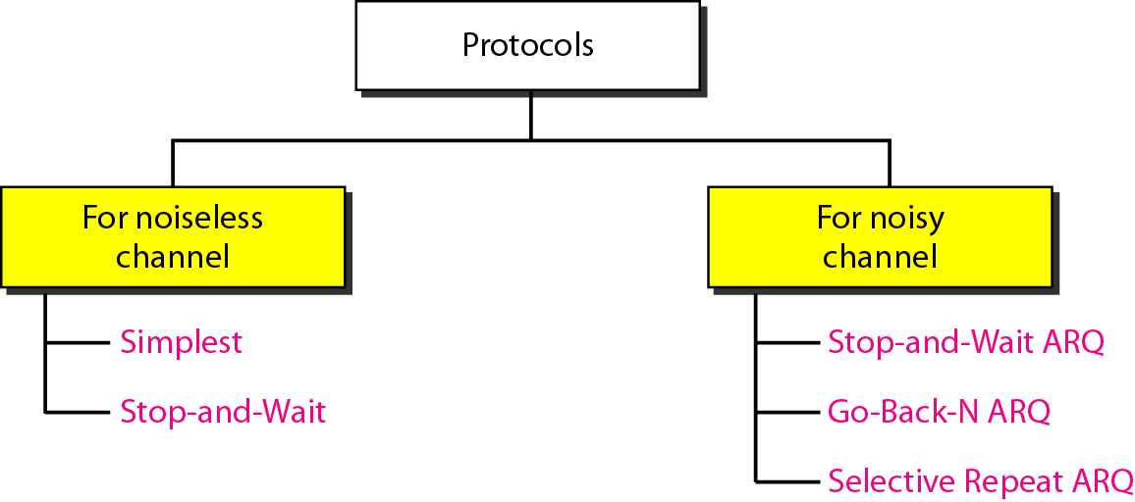
Taxonomy of protocols

Slide 56
Noiseless Channels
Two protocols are used for ideal cases having noiseless channels
Simplest Protocol
Stop-and-Wait Protocol

Slide 57
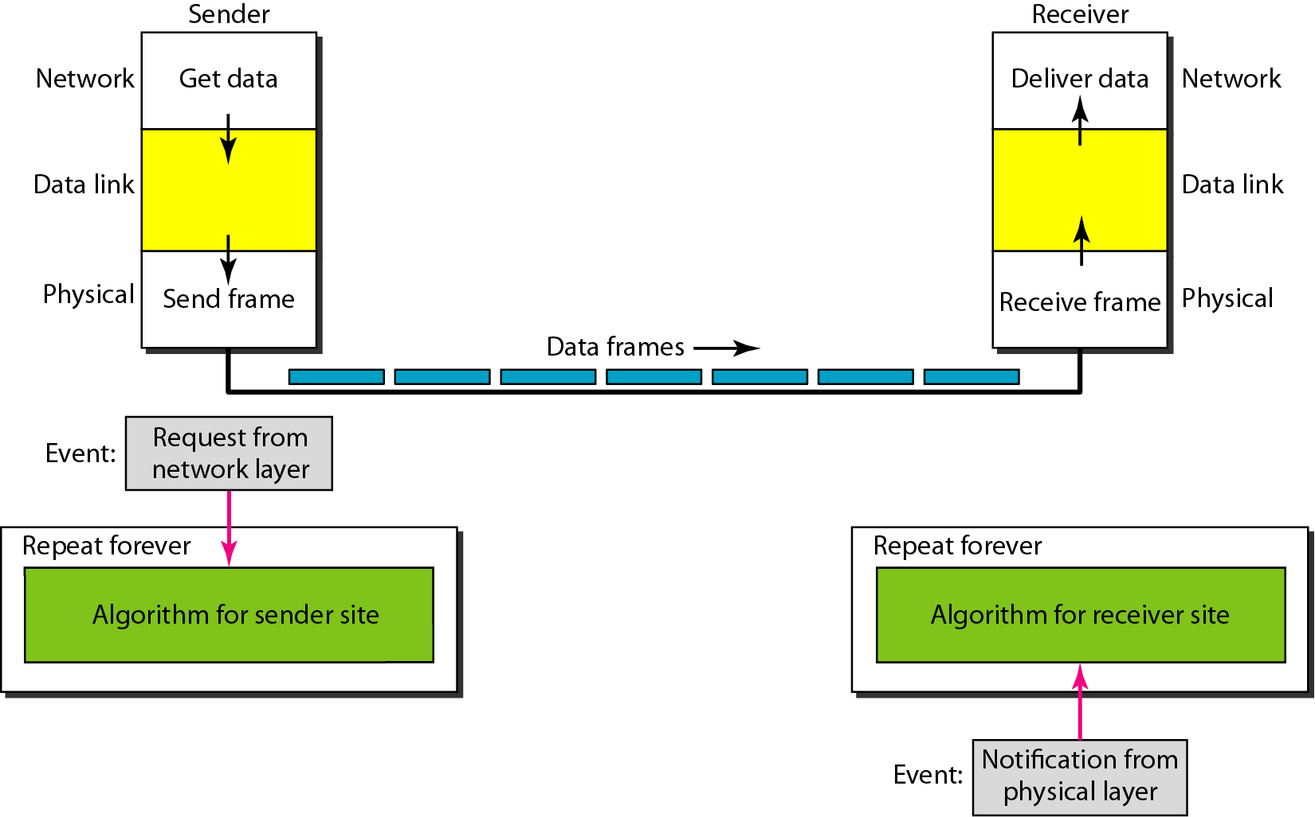
Simple Protocol
Let us first assume we have an ideal channel in which no frames are lost, duplicated, or corrupted. We introduce two protocols for this type of channel.

Slide 58
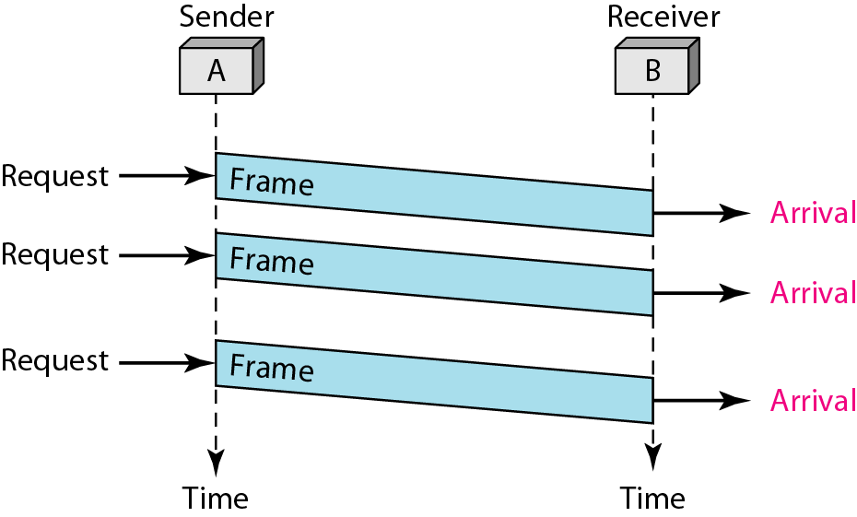
Simple Protocol
The sender sends a sequence of frames without even thinking about the receiver.
To send three frames, three events occur at the sender side and three events at the receiver side.
The data frames are shown by tilted boxes; the height of the box defines the transmission time difference between the first bit and the last bit in the frame.

Slide 59
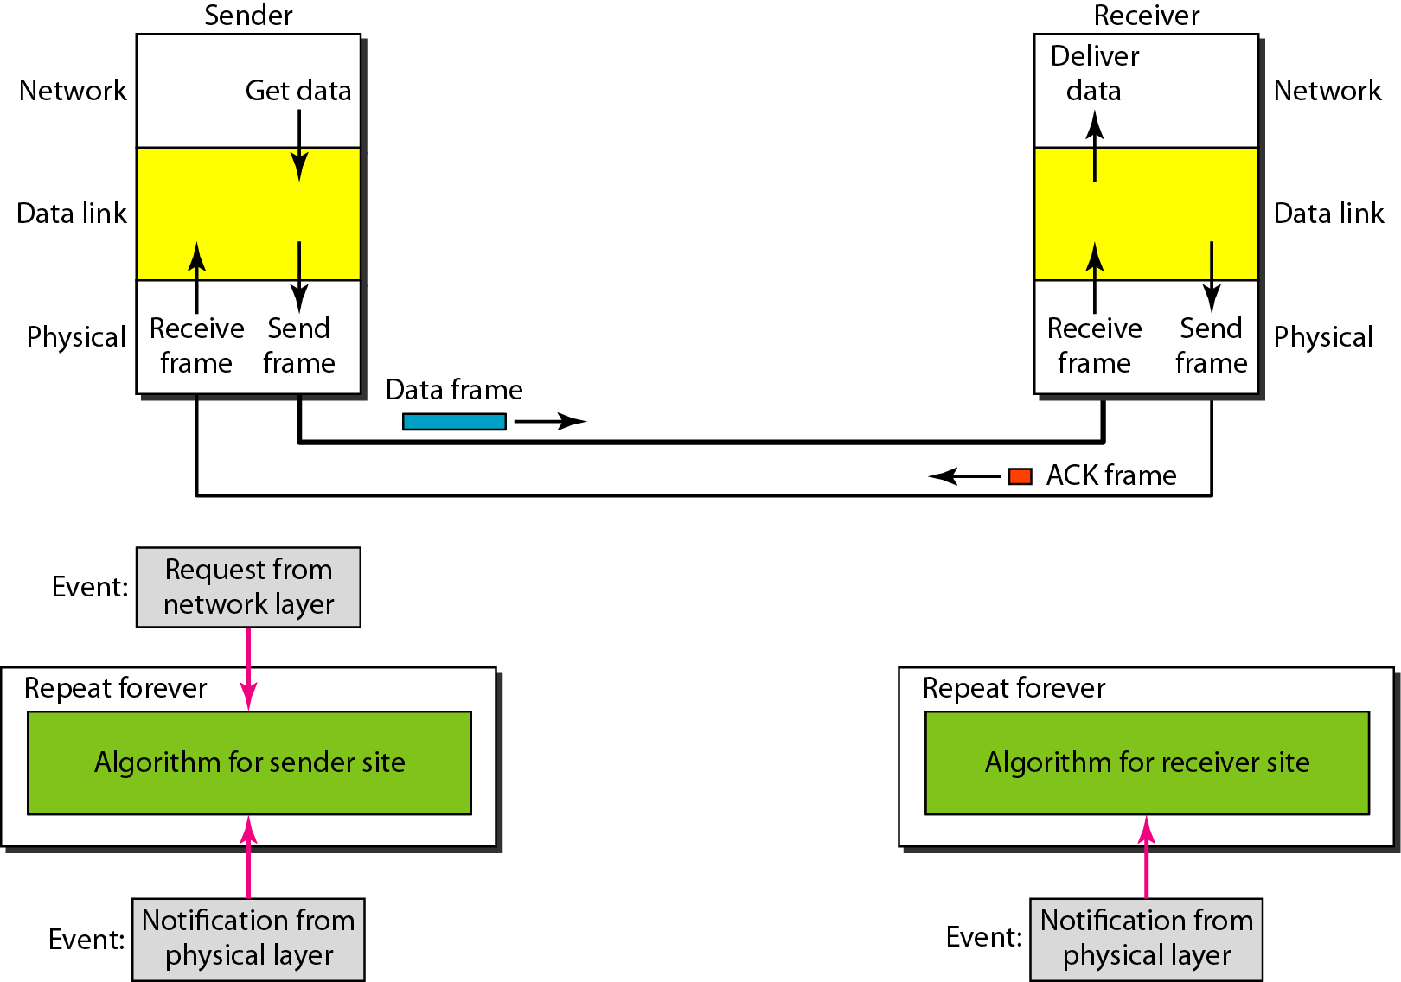
Stop & Wait Protocol
In this protocol, the sender sends one frame at a time and waits for an acknowledgment before sending the next one.

Slide 60
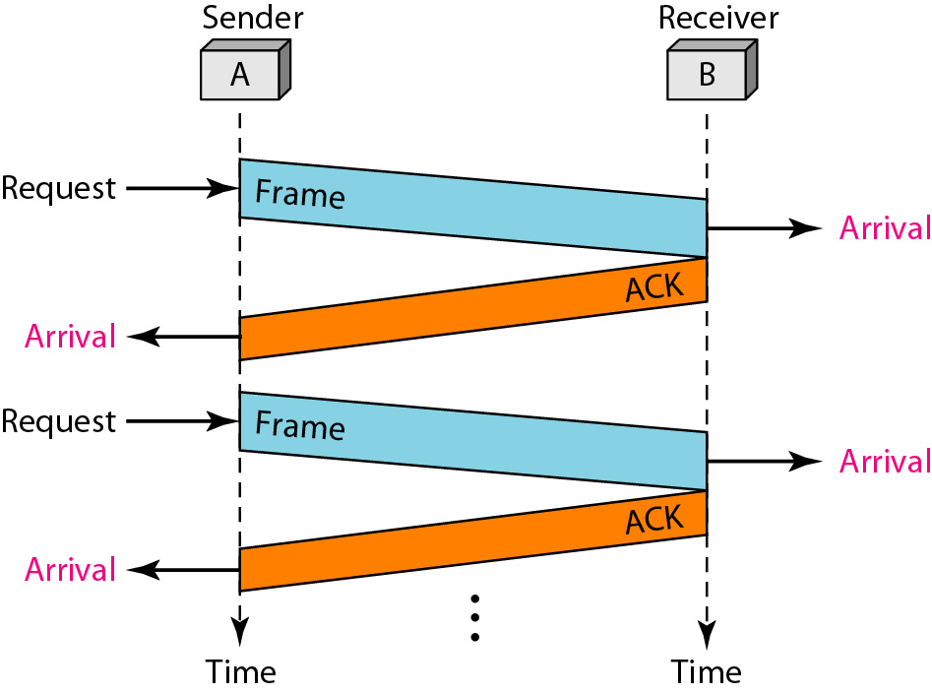
Stop & Wait Protocol
The sender sends one frame and waits for feedback from the receiver.
When the ACK arrives, the sender sends the next frame.
Note that sending two frames in the protocol involves the sender in four events and the receiver in two events.

Slide 61
Noisy Channel
Noiseless channels are nonexistent.
For noisy channels, following protocols are used for flow and error control
Stop-and-Wait Automatic Repeat Request
Go-Back-N Automatic Repeat Request
Selective Repeat Automatic Repeat Request

Slide 62
Stop-and-Wait Automatic Repeat Request
To detect corrupted frames, we need to add a CRC to each data frame. When a frame arrives at the receiver site, it is checked. If its CRC is incorrect, the frame is corrupted and silently discarded.
Every time the sender sends a frame, it starts a timer. If an acknowledgment arrives before the timer expires, the timer is stopped and the sender sends the next frame (if it has one to send).
If the timer expires, the sender resends the previous frame, assuming that the frame was either lost or corrupted.
Sender needs to keep a copy of the frame until its acknowledgment arrives. When the corresponding acknowledgment arrives, the sender discards the copy and sends the next frame if it is ready.
Note that only one frame and one acknowledgment can be in the channels at any time.

Slide 63
Characteristics of Stop-and-Wait ARQ
The stop and wait ARQ is a sliding window protocol with a window size equal to 1.
The stop and wait ARQ is an example of the Closed Loop OR connection-oriented.
The sender sends the data frame with a sequence number.
The sender also maintains a copy of the data frame that is being currently sent so that if the ACK is not received then the sender can re-transmit the frame.
The sender can send only one frame at a time and the receiver can also receive only one frame at a time.
In the stop and wait ARQ, the sender needs to maintain a time tracker.
To detect corrupted frames, we need to add a CRC to each data frame. When a frame arrives at the receiver site, it is checked.

Slide 64
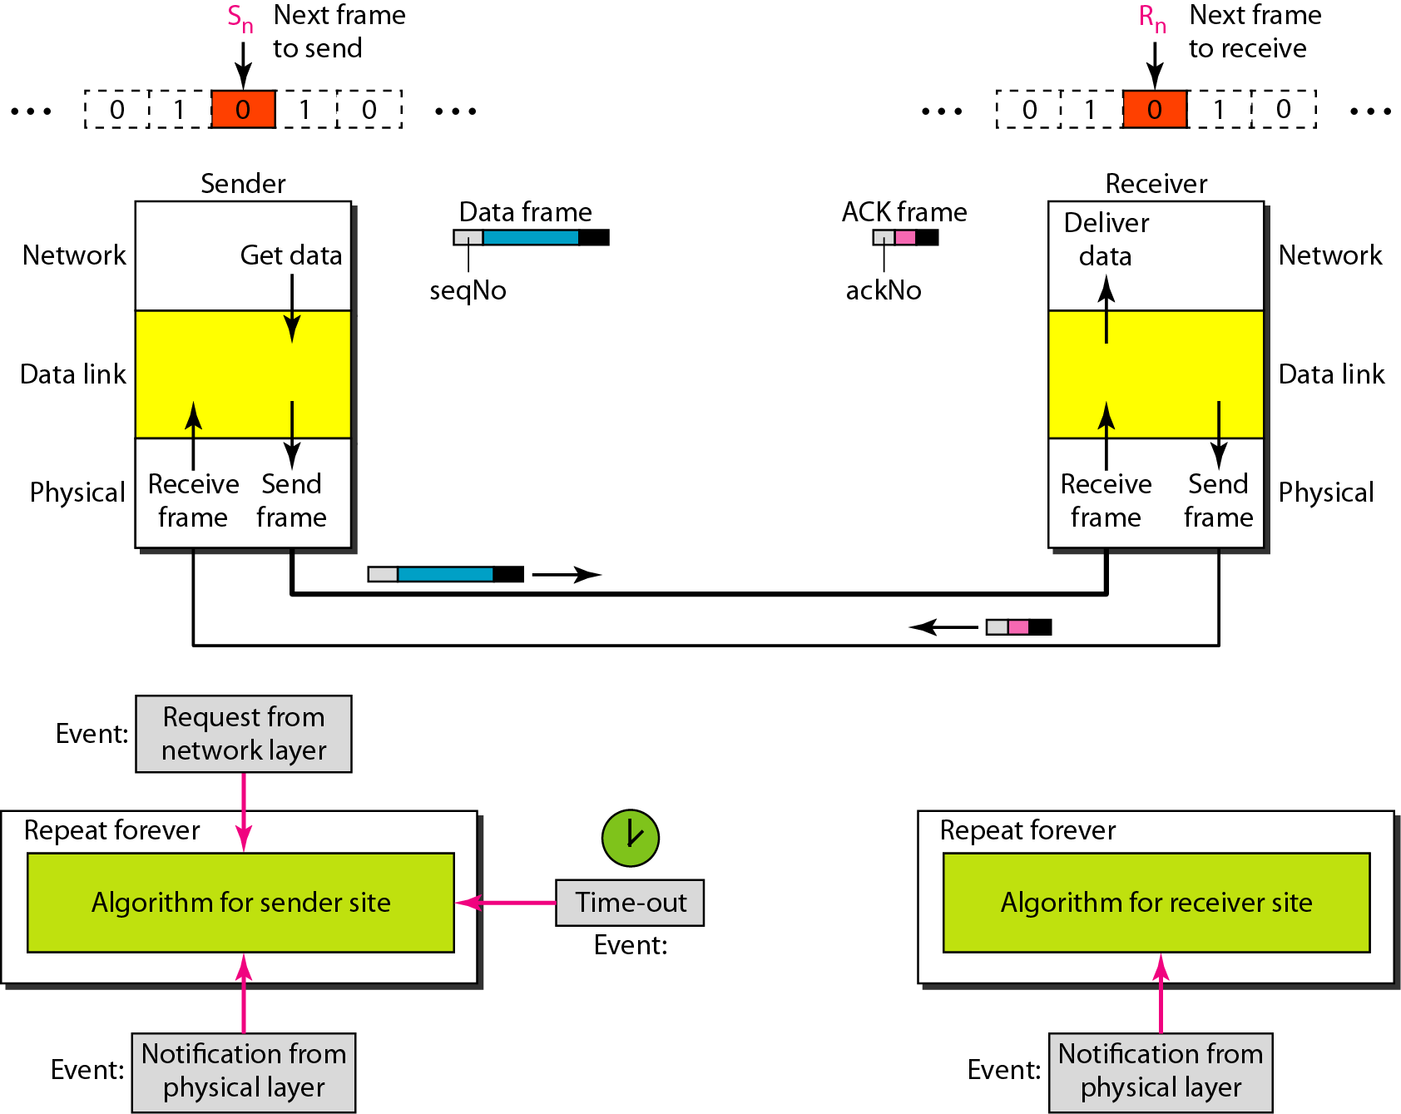
Stop-and-Wait Automatic Repeat Request

Slide 65
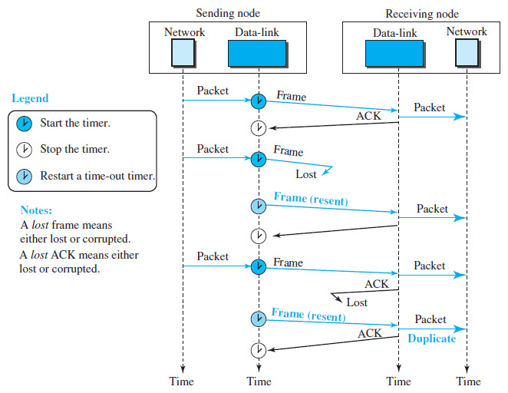
Stop-and-Wait [without sequence number]

Slide 66
Stop-and-Wait [without sequence number]
Duplicate packets, as much as corrupted packets, need to be avoided.
To correct the problem, we need to add sequence numbers to the data frames and acknowledgment numbers to the ACK frames.
A 1-bit sequence number/acknowledgement number (0 or 1) is therefore sufficient.

Slide 67
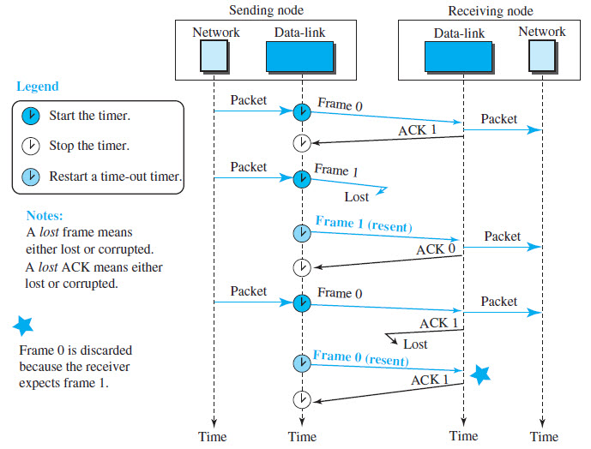
Stop-and-Wait [with sequence number]

Slide 68
Stop-and-Wait Automatic Repeat Request
Error correction in Stop-and-Wait ARQ is done by keeping a copy of the sent frame and retransmitting of the frame when the timer expires.
In Stop-and-Wait ARQ, we use sequence numbers to number the frames. The sequence numbers are based on modulo-2 arithmetic.
In Stop-and-Wait ARQ, the acknowledgment number always announces in modulo-2 arithmetic the sequence number of the next frame expected.
Aim of stop & wait protocol is to turn unreliable data link into reliable one
Therefore Stop & Wait protocol is suitable for large sizes of packets.
Similarly Stop & Wait protocol is suitable for small size networks(i.e. LAN)

Slide 69
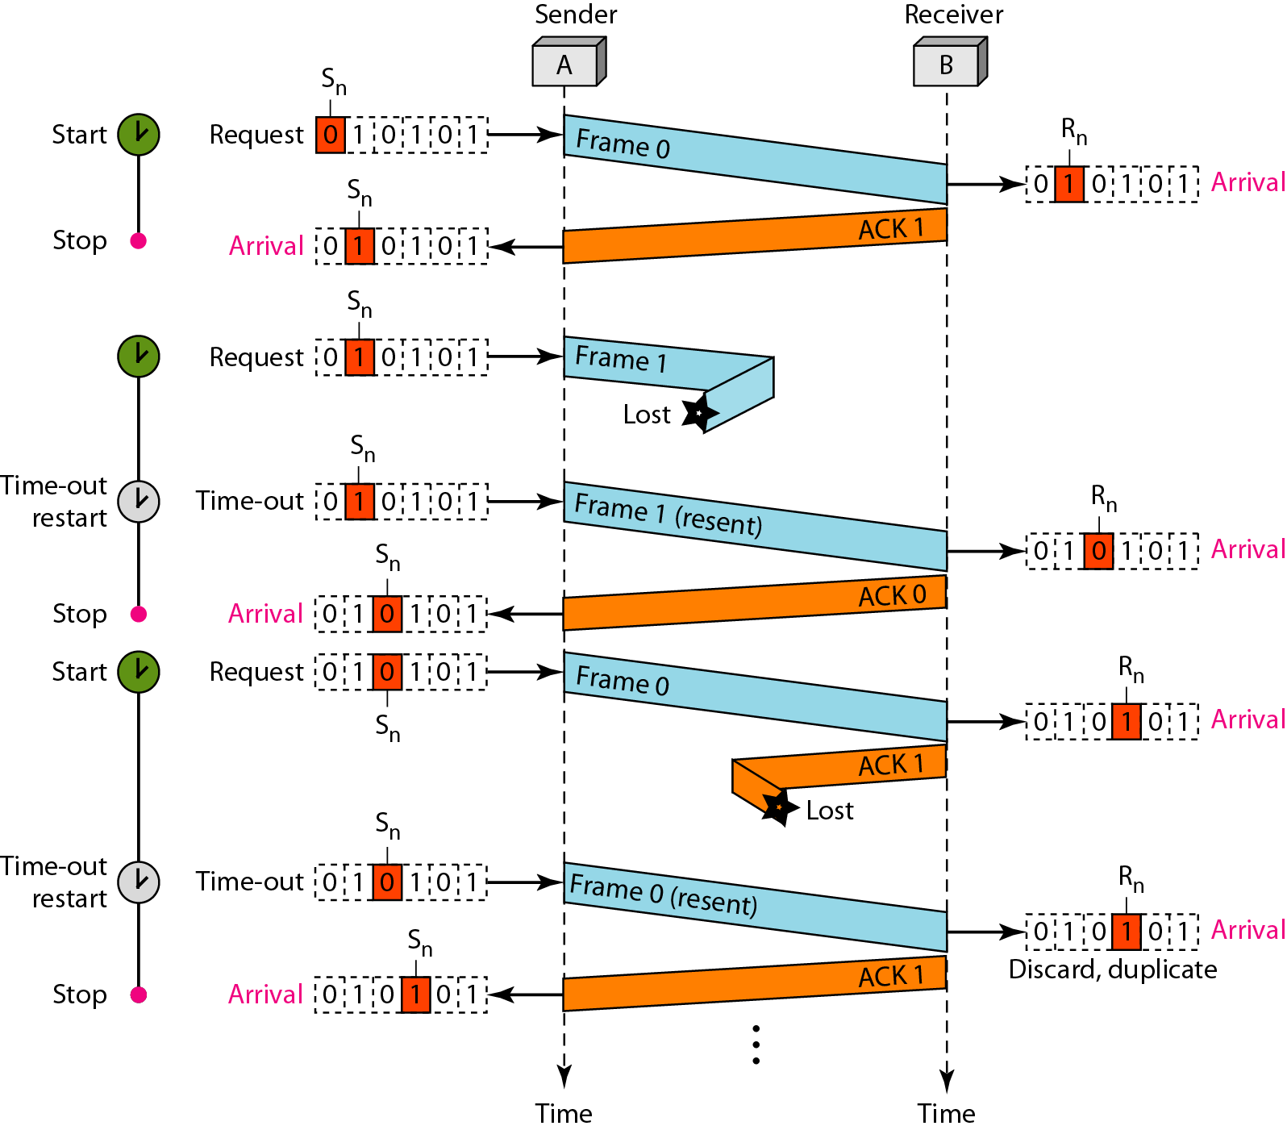
Stop-and-Wait Automatic Repeat Request: Example
Frame 0 is sent and acknowledged. Frame 1 is lost and resent after the time-out.
The resent frame 1 is acknowledged and the timer stops.
Frame 0 is sent and acknowledged, but the acknowledgment is lost.
The sender has no idea if the frame or the acknowledgment is lost, so after the time-out, it resends frame 0, which is acknowledged.

Slide 70
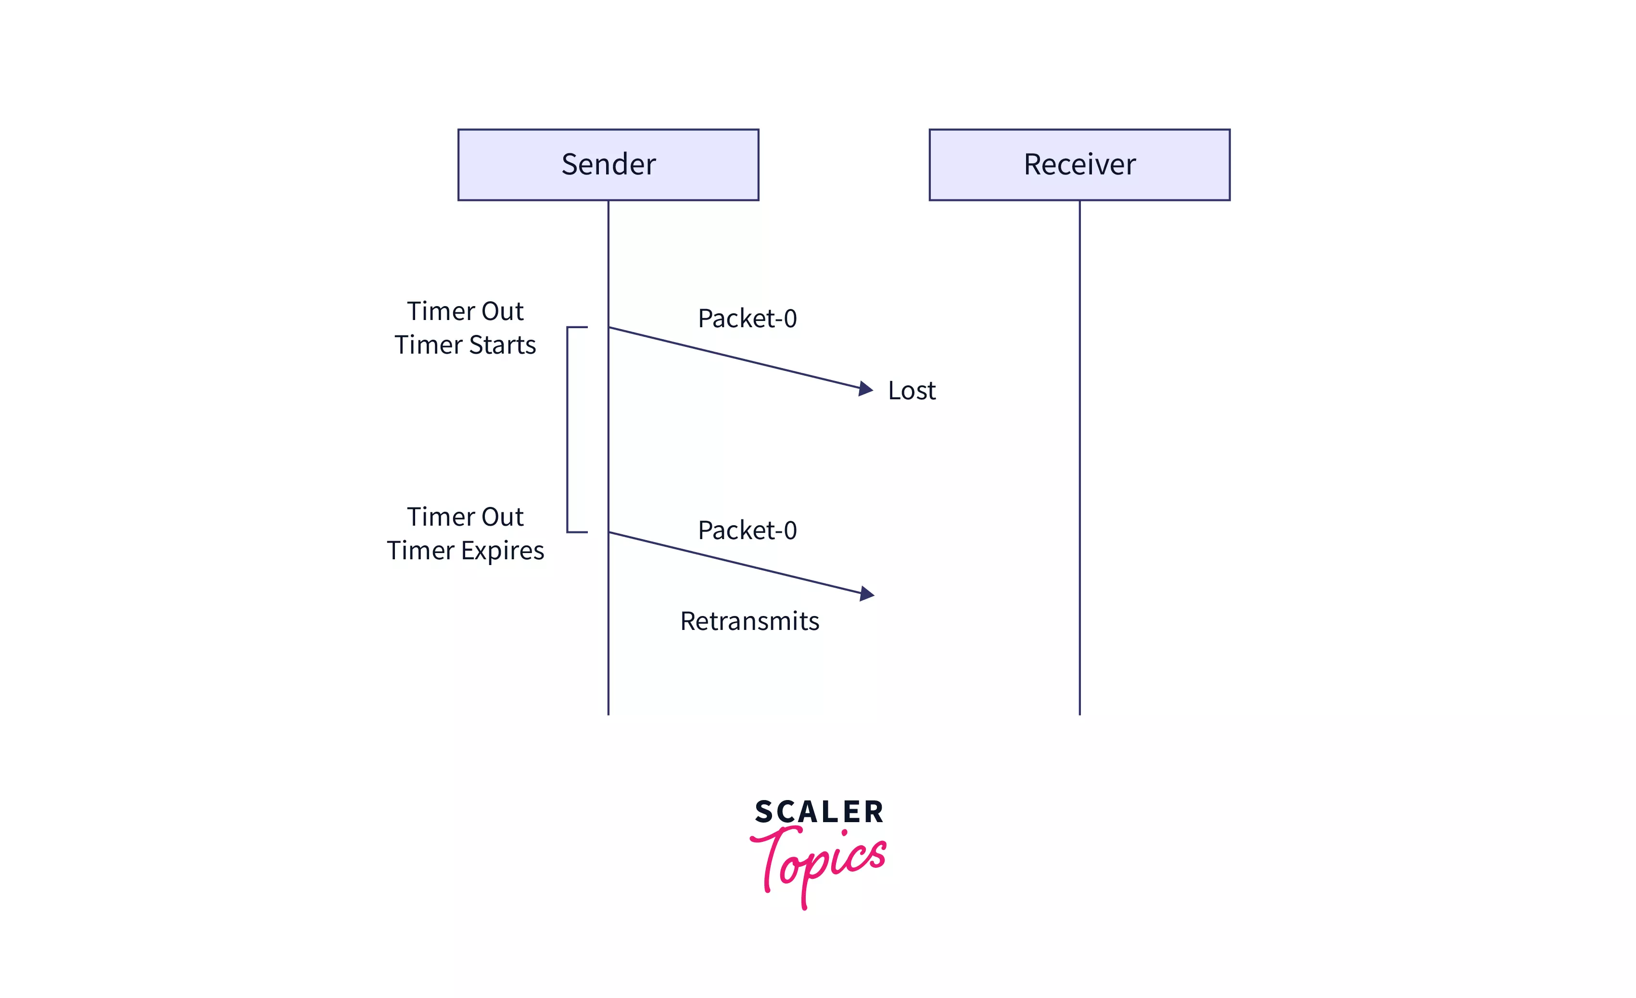
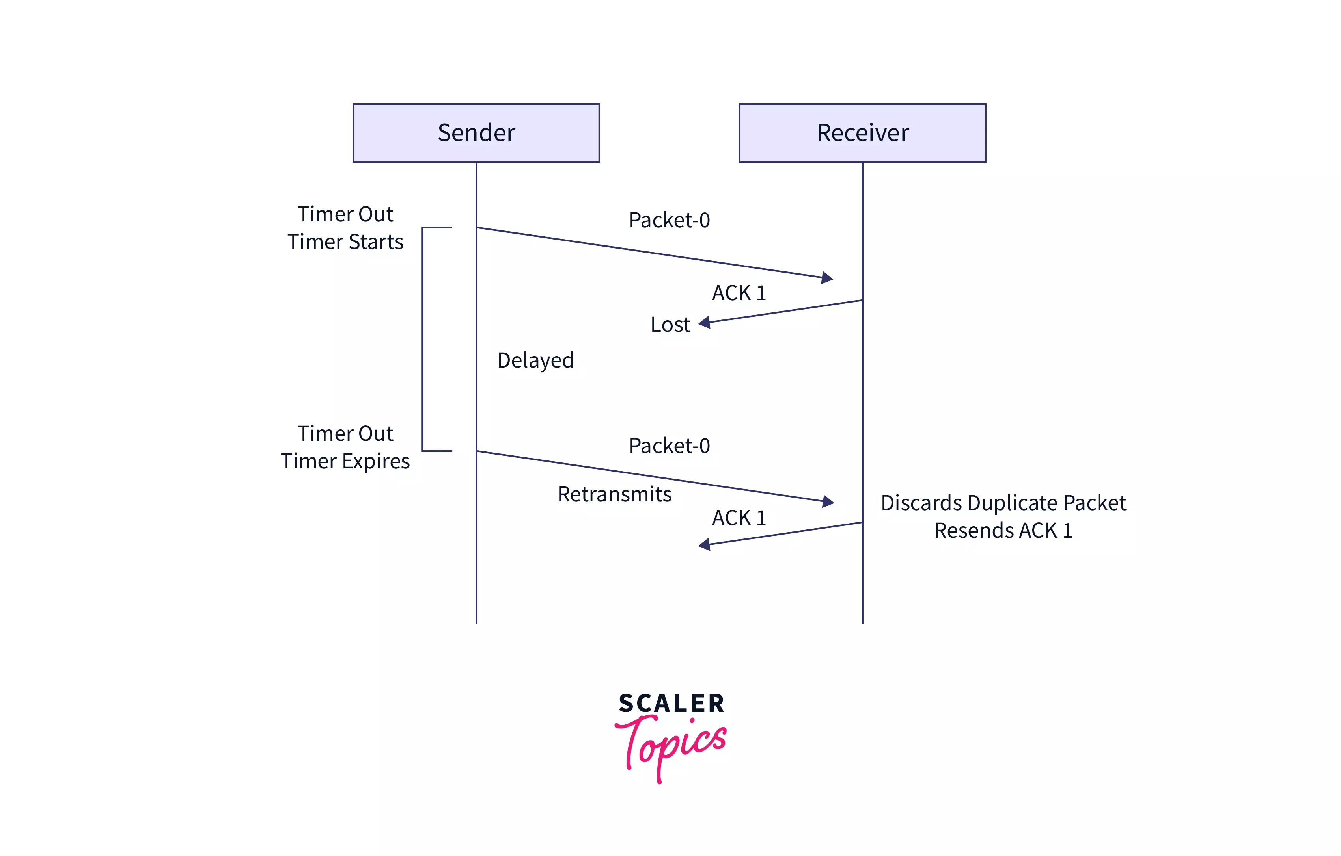
Stop-and-Wait Automatic Repeat Request
Problem of Lost Data Packet
Problem of Lost Acknowledgement

Slide 71
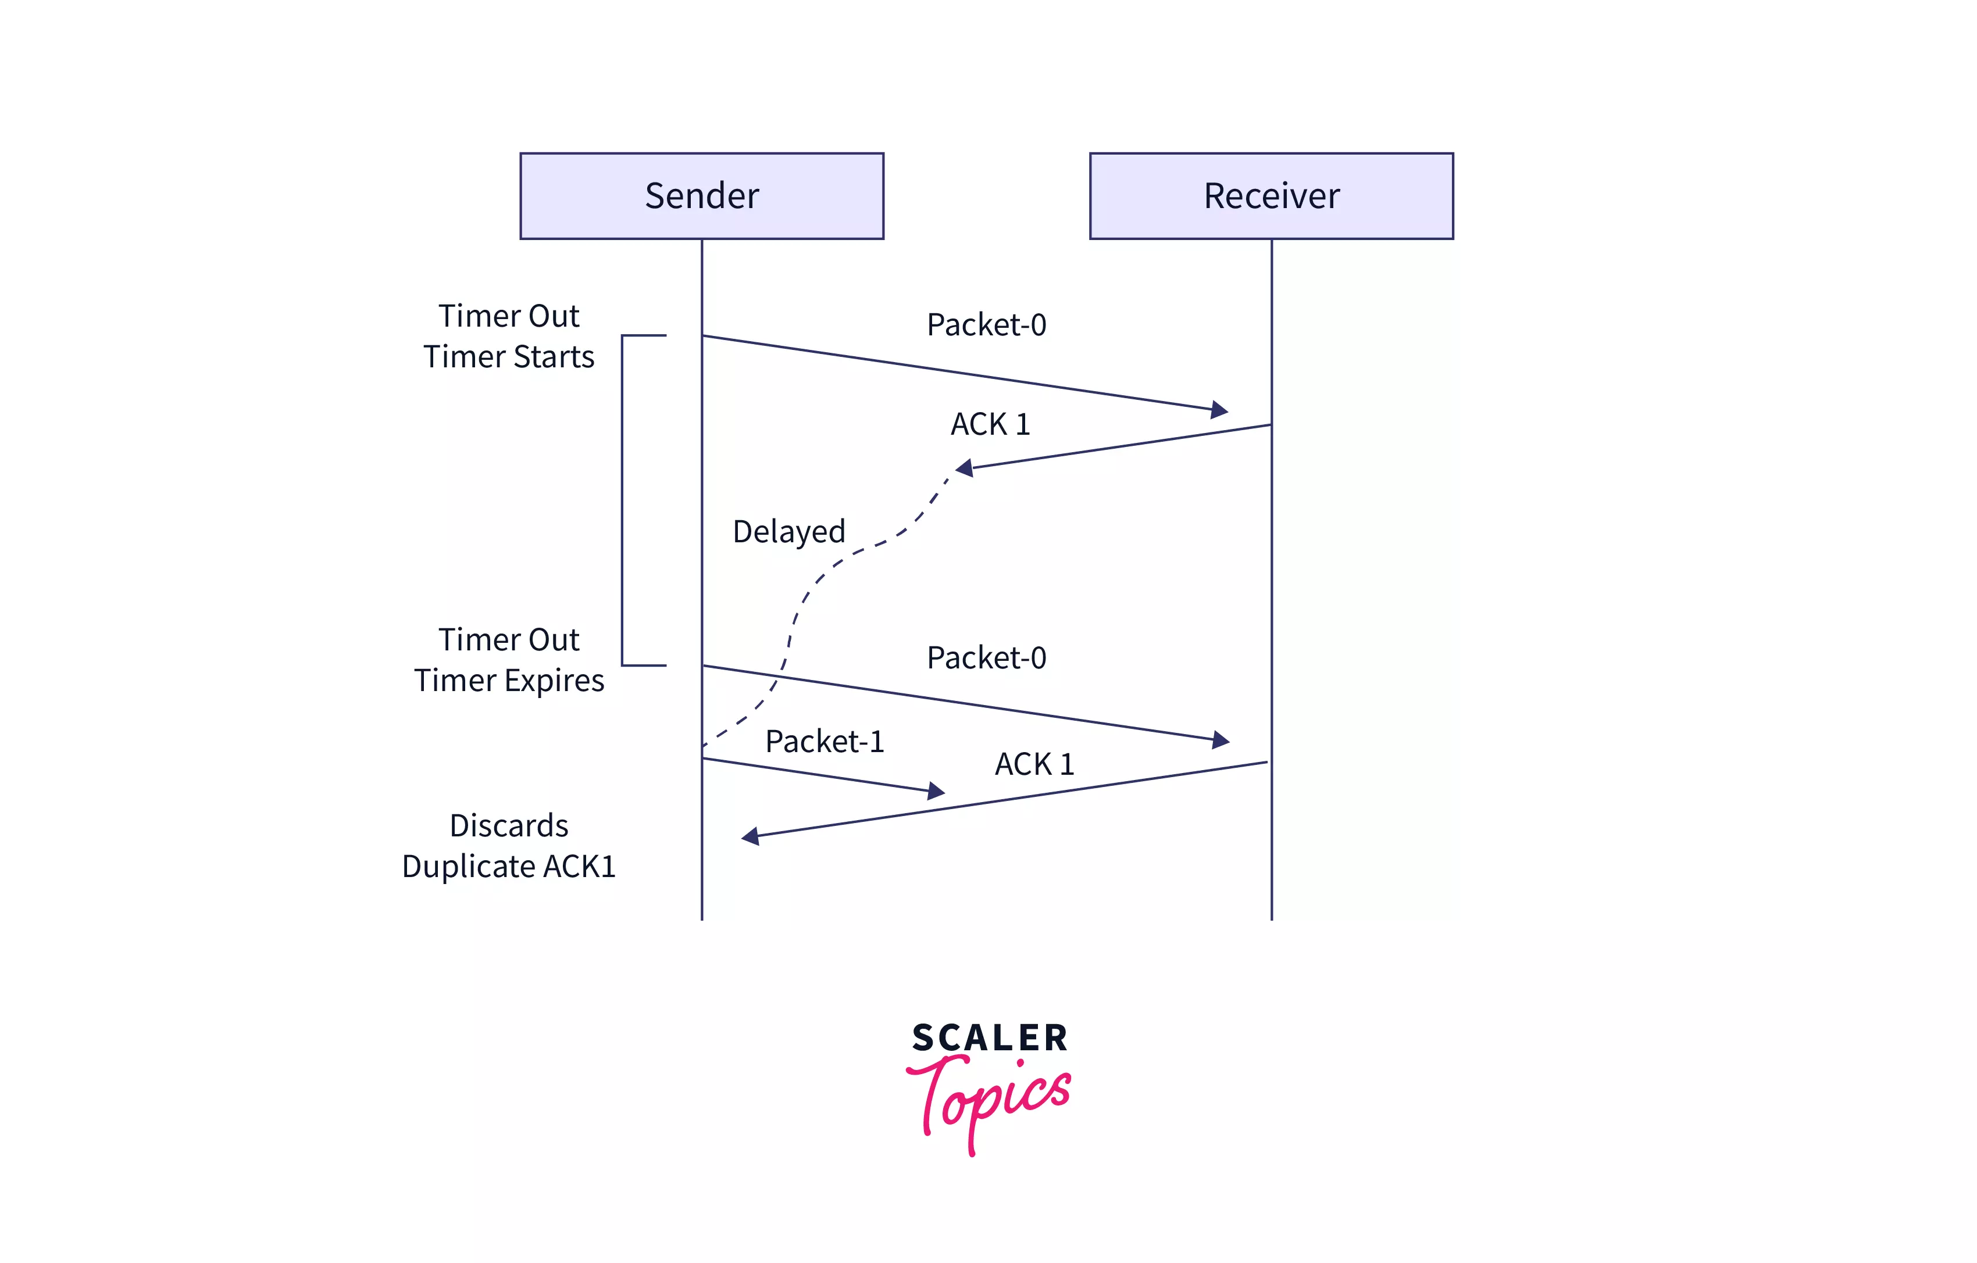
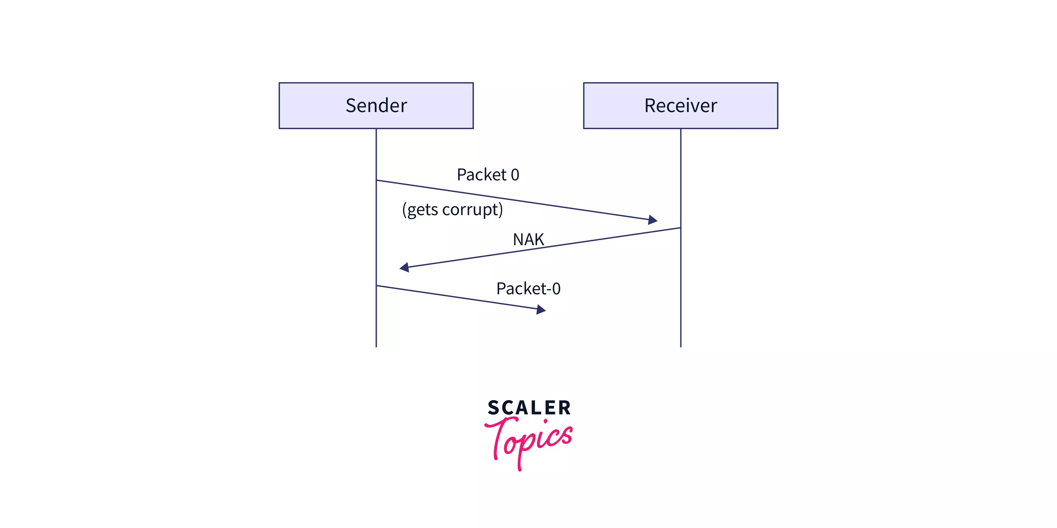
Stop-and-Wait Automatic Repeat Request
Problem of Delayed Acknowledgement
Problem of Damaged Packet

Slide 72
Advantages of Stop-and-Wait ARQ
The stop and wait ARQ can be used in both the data link layer and the transport layer.
The stop and wait ARQ provides both error management and flow control management.
The stop and wait ARQ works in half-duplex mode as at a time only the sender can send the message or the receiver can send the ACK.
The stop and wait ARQ ensures that the information is received by the receiver in the order it was sent.

Slide 73
Limitations of Stop-and-Wait ARQ
The data can be lost in between the transmission. So, in such a case, the sender waits for ACK and the receiver waits for the data frame for an infinite amount of time.
The ACK from the receiver may get lost in the channel. So, the sender waits for ACK for an infinite amount of time.
The window size of the sender and the receiver is only 1. So, only one frame can be sent at a time.
As there is a timer concept, so the sender must wait for a long duration before retransmission. Hence, the stop and wait ARQ is a slow protocol.

Slide 74
Sliding Window Protocol
The sliding window is a technique for sending multiple frames at a time.
It controls the data packets between the two devices where reliable and gradual delivery of data frames is needed
In this technique, each frame has sent from the sequence number.
The sequence numbers are used to find the missing data in the receiver end.
The purpose of the sliding window technique is to avoid duplicate data, so it uses the sequence number.

Slide 75
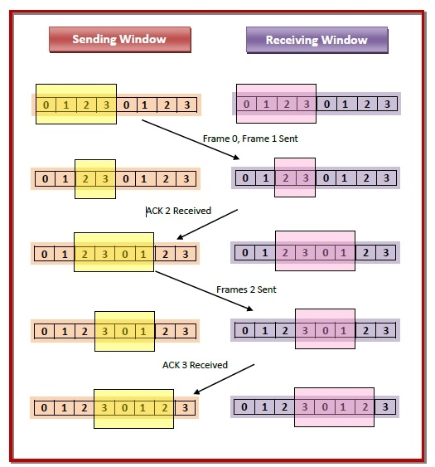
Sliding Window Protocol
Suppose that we have sender window and receiver window each of size 4.
So the sequence numbering of both the windows will be 0,1,2,3,0,1,2 and so on.
The diagram shows the positions of the windows after sending the frames and receiving acknowledgments.

Slide 76
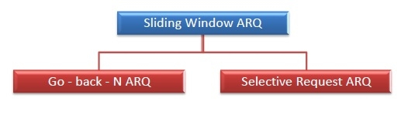
Types of Sliding Window Protocol

Slide 77
Go-Back-N ARQ
Go-Back-N ARQ protocol is also known as Go-Back-N Automatic Repeat Request.
It is a data link layer protocol that uses a sliding window method.
In this, if any frame is corrupted or lost, all subsequent frames have to be sent again.
The frames are sequentially numbered and a finite number of frames are sent.
If the acknowledgment of a frame is not received within the time period, all frames starting from that frame are retransmitted.

Slide 78
Go-Back-N ARQ
In these protocols, the sender has a buffer called the sending window and the receiver has buffer called the receiving window.
The size of the sending window determines the sequence number of the outbound frames.
If the sequence number of the frames is an n-bit field, then the range of sequence numbers that can be assigned is 0 to 2^{𝑛}−1.
Consequently, the size of the sending window is 2^{𝑛}−1. Thus in order to accommodate a sending window size of 2^{𝑛}−1, a n-bit sequence number is chosen.
The sequence numbers are numbered as modulo-n.
For example, if the sending window size is 4, then the sequence numbers will be 0, 1, 2, 3, 0, 1, 2, 3, 0, 1, and so on. The number of bits in the sequence number is 2 to generate the binary sequence 00, 01, 10, 11.
The size of the receiving window is the maximum number of frames that the receiver can accept at a time.
It determines the maximum number of frames that the sender can send before receiving acknowledgment.

Slide 79
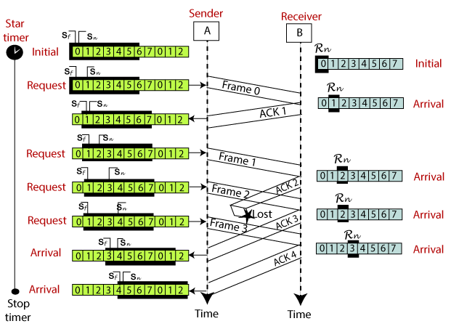
Go-Back-N ARQ

Slide 80
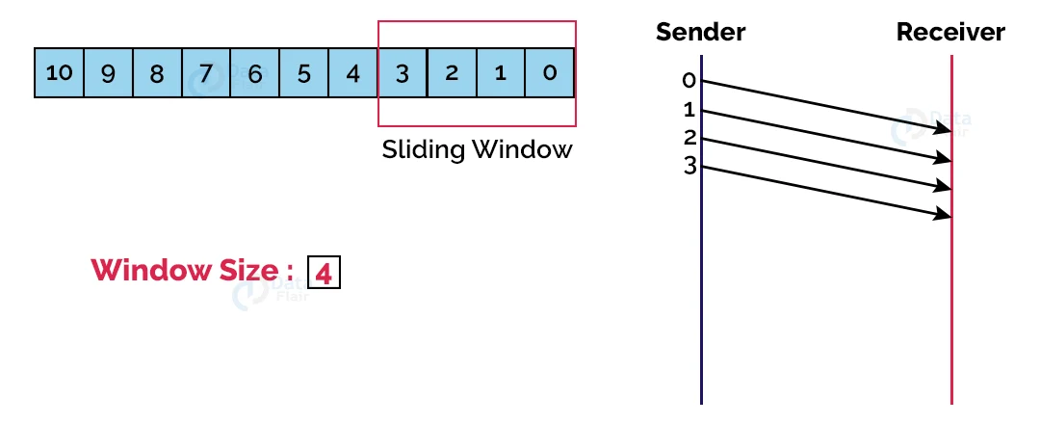
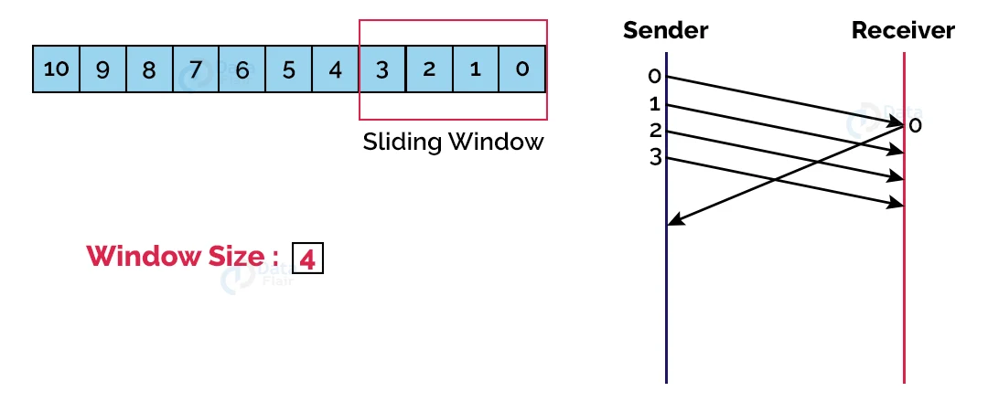
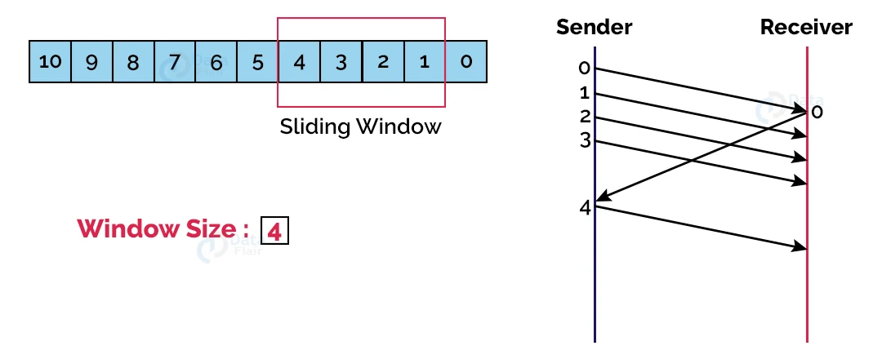


Go-Back-N ARQ
.In Go Back 4 ARQ, the size of the sender window is 4.

Slide 81
Advantages of Go-Back-N ARQ
Advantages of Go-Back-N ARQ
It can send multiple frames at once.
Pipelining is present in the Go-Back-N ARQ i.e. a frame can be sent by the sender before receiving the acknowledgment of the previously sent frame. This results in a lesser waiting time for the frame.
It handles corrupted as well as out-of-order frames which result in minimal frame loss.
Disadvantages of Go-Back-N ARQ
If acknowledgment for a frame is not received, the whole window of frames is retransmitted instead of just the corrupted frame. This makes the Go Back N ARQ protocol inefficient.
Retransmission of all the frames on detecting a corrupted frame increases channel congestion and also increases the bandwidth requirement.
It is more time-consuming because while retransmitting the frames on detecting a corrupted frame, the error-free frames are also transmitted.

Slide 82
Selective Repeat ARQ
The Go-back-N ARQ protocol works well if it has fewer errors.
But if there is a lot of error in the frame, lots of bandwidth loss in sending the frames again.
In the Selective Repeat ARQ protocol, the size of the sender window is always equal to the size of the receiver window. The size of the sliding window is always greater than 1.
If the receiver receives a corrupt frame, it does not directly discard it.
It sends a negative acknowledgment to the sender.
The sender sends that frame again as soon as on the receiving negative acknowledgment.
There is no waiting for any time-out to send that frame.

Slide 83

Selective Repeat ARQ

Slide 84

Selective Repeat ARQ

Slide 85

Selective Repeat ARQ

Slide 86
Advantages of Selective Repeat ARQ
Efficient Data Transmission:
Minimized Congestion:
Faster Recovery
Optimized Network Utilization:
Improved Reliability:
Supports High Error Rates:
Adaptive:
Higher Throughput:
Minimal Latency:
Efficient for Large Windows:

Slide 87
Disadvantages of Selective Repeat ARQ
Increased Complexity:
Higher Overhead: Out-of-Order Delivery:
Retransmission Overhead:
Increased Delay:
Synchronization Dependency:

Slide 88


Slide 89

Channel Allocation
Channel allocation is a process in which a single channel is divided and allotted to multiple users in order to carry user specific tasks.
Channel Allocation Strategies are designed in such a way that there is efficient use of frequencies, time slots and bandwidth.

Slide 90
Static Channel Allocation
In static channel allocation scheme, a fixed portion of the frequency channel is allotted to each user.
For N competing users, the bandwidth is divided into N channels using frequency division multiplexing (FDM), and each portion is assigned to one user.
This scheme is also referred as fixed channel allocation or fixed channel assignment.
In this allocation scheme, there is no interference between the users since each user is assigned a fixed channel.
However, it is not suitable in case of a large number of users with variable bandwidth requirements

Slide 91
Dynamic Channel Allocation
In dynamic channel allocation scheme, frequency bands are not permanently assigned to the users.
Instead channels are allotted to users dynamically as needed, from a central pool.
The allocation is done considering a number of parameters so that transmission interference is minimized.
This allocation scheme optimizes bandwidth usage and results is faster transmissions.
Dynamic channel allocation is further divided into centralized and distributed allocation.

Slide 92
Multiple Access Protocol
The data link layer is used in a computer network to transmit the data between two devices or nodes.
It divides the layer into two parts such as data link control and the multiple access resolution/protocol.
The upper layer has the responsibility to flow control and the error control in the data link layer, and hence it is termed as logical data link control.
Whereas the lower sub-layer is used to handle and reduce the collision or multiple access on a channel.
Hence it is termed as media access control or the multiple access resolutions.

Slide 93

Multiple Access Protocols

Slide 94
Random Access Protocol
No station is superior to another station and none is assigned the control over another.
No station permits, or does not permit, another station to send.
There is no fixed time for sending data
There is no fixed sequence of stations sending data
Protocols
ALOHA (Pure ALOHA and Slotted ALOHA)
CSMA (Carrier Sense Multiple Access)
CSMA/CD (Carrier Sense Multiple Access/Collision Detection)
CSMA/CA (Carrier Sense Multiple Access/Collision Avoidance)

Slide 95
ALOHA
It is designed for wireless LAN (Local Area Network) but can also be used in a shared medium to transmit data.
Aloha Rules
Any station can transmit data to a channel at any time.
It does not require any carrier sensing.
Collision and data frames may be lost during the transmission of data through multiple stations.
Acknowledgment of the frames exists in Aloha. Hence, there is no collision detection.
It requires retransmission of data after some random amount of time.

Slide 96

ALOHA

Slide 97
Pure ALOHA
In pure Aloha each station transmits data to a channel without checking whether the channel is idle or not
The chances of collision may occur, and the data frame can be lost.
When any station transmits the data frame to a channel, the pure Aloha waits for the receiver's acknowledgment.
If it does not acknowledge the receiver end within the specified time, the station waits for a random amount of time, called the backoff time (Tb).
The station may assume the frame has been lost or destroyed.
Therefore, it retransmits the frame until all the data are successfully transmitted to the receiver.

Slide 98

Pure ALOHA

Slide 99

Pure ALOHA
There are four stations for accessing a shared channel and transmitting data frames.
Some frames collide because most stations send their frames at the same time.
Only two frames, frame 1.1 is successfully transmitted to the receiver end. Frame 3.2 is also successful.
At the same time, other frames are lost or destroyed.
Whenever two frames fall on a shared channel simultaneously, collisions can occur, and both will suffer damage.
If the new frame's first bit enters the channel before finishing the last bit of the second frame.

Slide 100
Pure ALOHA
Efficiency-
Efficiency of Pure Aloha (η) = G x e^{-2G}
where G = Number of stations willing to transmit data
Maximum Efficiency-
For maximum efficiency,
We put dη / dG = 0
Maximum value of η occurs at G = 1/2
Substituting G = 1/2 in the above expression, we get-
Maximum efficiency of Pure Aloha
= 1/2 x e^{-2 x 1/2}
= 1 / 2e
= 0.184
= 18.4%

Slide 101

Vulnerable period for Pure ALOHA

Slide 102
Slotted ALOHA
In slotted Aloha, the shared channel is divided into a fixed time interval called slots.
if a station wants to send a frame to a shared channel, the frame can only be sent at the beginning of the slot, and only one frame is allowed to be sent to each slot.
if the stations are unable to send data to the beginning of the slot, the station will have to wait until the beginning of the slot for the next time.
However, the possibility of a collision remains when trying to send a frame at the beginning of two or more station time slot.

Slide 103

Slotted ALOHA

Slide 104
Slotted ALOHA
Efficiency-
Efficiency of Slotted Aloha (η) = G x e^{-G}
where G = Number of stations willing to transmit data at the beginning of the same time slot
Maximum Efficiency-
For maximum efficiency,
We put dη / dG = 0
Maximum value of η occurs at G = 1
Substituting G = 1 in the above expression, we get-
Maximum efficiency of Slotted Aloha
= 1 x e⁻¹
= 1 / e
= 0.368
= 36.8%

Slide 105

Vulnerable period for Slotted ALOHA

Slide 106
Key | Pure Aloha | Slotted Aloha
Time Slot | In Pure Aloha, any station can transmit data at any time. | In Slotted Aloha, any station can transmit data only at the beginning of a time slot.
Time | In Pure Aloha, time is continuous and is not globally synchronized. | In Slotted Aloha, time is discrete and is globally synchronized.
Vulnerable time | The vulnerable time or susceptible time in Pure Aloha is equal to (2×Tt). | In Slotted Aloha, the vulnerable time is equal to (Tt).
Probability | The probability of successful transmission of a data packet (η) = G x e^{-2G} | The probability of successful transmission of a data packet (η) = G x e^{-G}
Maximum efficiency | Maximum efficiency = 18.4%. | Maximum efficiency = 36.8%.
Number of collisions | Does not reduce the number of collisions. | Slotted Aloha reduces the number of collisions to half, thus doubles the efficiency.

Slide 107
Carrier Sense MA protocols
It is a carrier sense multiple access based on media access protocol to sense the traffic on a channel (idle or busy) before transmitting the data.
It means that if the channel is idle, the station can send data to the channel. Otherwise, it must wait until the channel becomes idle.
Hence, it reduces the chances of a collision on a transmission medium.
CSMA method was developed to decrease the chances of collisions when 2 or more stations start sending their signals over the data link layer
Approach of protocol: Sense before transmit or Listen before talk
Sense the channel before transmission of frames
Listen the channel, if no activity means channel is idle then transmit the frames

Slide 108

Carrier Sense MA protocols – Vulnerable times

Slide 109

Carrier Sense MA protocols
But, what to do if the channels are busy? Now, here the persistence methods can be applied to help the station act when the channel is busy or idle.

Slide 110
Carrier Sense MA protocols
The CSMA has 4 access modes:
1-persistent mode
Non-persistent mode
P-persistent mode
O-persistent
1-persistent mode: In this, first the node checks the channel, if the channel is idle then the node or station transmits data, otherwise it keeps on waiting and whenever the channel is idle, the stations transmit the data-frame.

Slide 111
Carrier Sense MA protocols
Non-persistent mode: In this, the station checks the channel similarly as 1-persistent mode, but the only difference is that when the channel is busy it checks it again after a random amount of time, unlike the 1-persistent where the stations keep on checking continuously.
P-persistent mode: In this, the station checks the channel and if found idle then it transmits the data frame with the probability of P and if the data is not transmitted (1-P) then the station waits for a random amount of time and again transmits the data with the probability P and this cycle goes on continuously until the data-frame is successfully sent.
O-persistent: In this, the transmission occurs based on the superiority of stations which is decided beforehand and transmission occurs in that order. If the channel is idle, then the station waits for its turn to send the data-frame.

Slide 112


Carrier Sense Multiple Access (CSMA)
1-persistent mode

Slide 113


Carrier Sense Multiple Access (CSMA)
Non-persistent mode

Slide 114


Carrier Sense Multiple Access (CSMA)
P-persistent mode

Slide 115
Carrier Sense Multiple Access (CSMA)
O-persistent mode
In this method of CSMA supervisory node assign a transmission order to each node in the network.
When the channel was idle instead of immediately sending the data channel will wait for its transmission order assigned to them.
This mode of CSMA defines the superiority of the station before data transmission in the medium. In this mode, if the channel is inactive then all stations will wait to transmit the data for its turn.
Every station in the channel transmits the data in its turn.

Slide 116
CSMA with Collision Detection
It is a carrier sense multiple access/ collision detection network protocol to transmit data frames.
The CSMA/CD protocol works with a medium access control layer.
Therefore, it first senses the shared channel before broadcasting the frames, and if the channel is idle, it transmits a frame to check whether the transmission was successful.
If the frame is successfully received, the station sends another frame.
If any collision is detected in the CSMA/CD, the station sends a jam/ stop signal to the shared channel to terminate data transmission.
After that, it waits for a random time before sending a frame to a channel.

Slide 117


Slide 118

CSMA with Collision Detection

Slide 119

CSMA with Collision Detection

Slide 120

CSMA with Collision Detection
States of CSMA/CD: contention, transmission or idle

Slide 121
CSMA/CA (MACA) (Multiple Access with Collision Avoidance)
It is a carrier sense multiple access/collision avoidance network protocol for carrier transmission of data frames.
It is a protocol that works with a medium access control layer. When a data frame is sent to a channel, it receives an acknowledgment to check whether the channel is clear.
If the station receives only a single (own) acknowledgments, that means the data frame has been successfully transmitted to the receiver.
But if it gets two signals (its own and one more in which the collision of frames), a collision of the frame occurs in the shared channel. Detects the collision of the frame when a sender receives an acknowledgment signal.
Following are the methods used in the CSMA/ CA to avoid the collision:

Slide 122

CSMA/CA (MACA) (Multiple Access with Collision Avoidance)

Slide 123

CSMA/CA (MACA) (Multiple Access with Collision Avoidance)

Slide 124

CSMA/CA (MACA) (Multiple Access with Collision Avoidance)

Slide 125

CSMA/CA (MACA) (Multiple Access with Collision Avoidance)

Slide 126

Persistent and Non-persistent CSMA
Comparison of the channel utilization versus load for various random access protocols.

Slide 127
References
Text Books:
Behrouz A. Forouzan, ‘Data Communications and Networking’, 5th Edition, McGraw-Hill Publishing Company, ISBN 978-0-07-337622-6
Tanenbaum A. S., ‘Computer Networks’, Pearson Education , 5th Edition, ISBN-978-0-13-212695-3
Reference Books:
James F. Kurose and Keith W Ross ‘Computer Networking, A Top-Down Approach’, 5th Edition, Pearson Education, ISBN- 978-81-317-9054-0
W. Richard Stevens, Unix Network Programming, The Sockets Networking API, Vol 1, 3rd Edition, PHI Learning Pvt. Ltd.
Supplementary Reading:
William Stallings, ‘Data and Computer Communications’, 6th Edition, Prentice Hall of India Pvt.
Web Resources:
https://nptel.ac.in/courses/106/105/106105080/
https://nptel.ac.in/courses/106/106/106106091/
Web links:
https://nptel.ac.in/courses/106/105/106105081/
https://nptel.ac.in/courses/106/105/106105183/
https://ocw.mit.edu/courses/electrical-engineering-and-computer-science/6-829-computer-networks-fall-2002/index.htm
MOOCs:
https://www.coursera.org/learn/computer-networking
https://www.edx.org/course/introduction-to-networking?index=product&queryID=0befdc538866babf2facfdc2dce06204&position=1

Slide 128
Thank You
Any Questions

